Slide 1
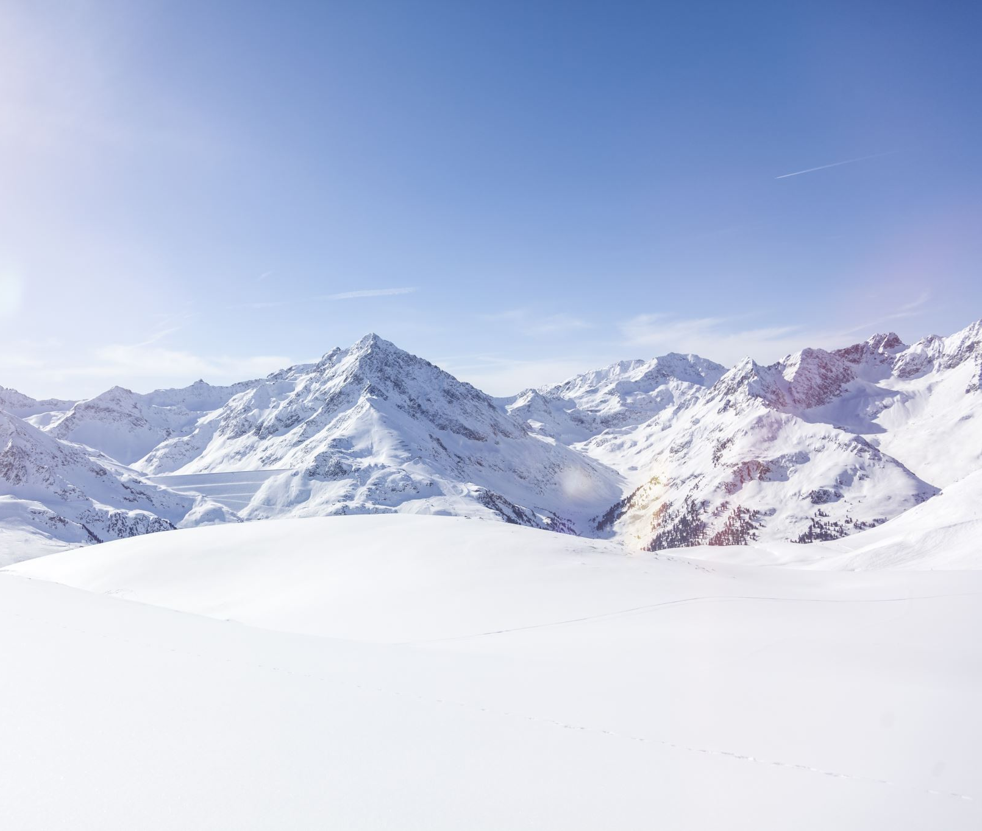
Big Mountain Resort
What value for the ticket price can the Big Mountain Resort select can yield a 5% increase in revenue?

Slide 2
Big Mountain Resort has been charging a premium above the average price of resorts in its market segment. However, there are limitations to this approach.
How should we select a better value for ticket price in order to increase revenue for the resort?
We will provide guidance on price selection by comparing different facilities that the Big Mountain Resort and the other 329 resorts have to determine how to capitalize on its facilities as much as it could.

Slide 3
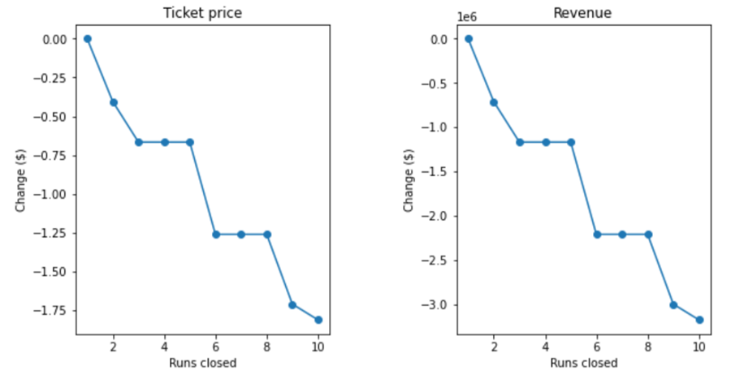
Recommendation
Close 1, 5, or 8 runs to reduce operation cost of runs.
Increase the vertical drop by adding a run to a point 150 feet lower down but requiring the installation of an additional chair lift to bring skiers back up, without additional snow making coverage. (Modelled ticket price +$1.99, revenue + $3474638 over the season)

Slide 4
Random Forest Model
Cross-validation test score:
mean= 0.7097384501425082, std= 0.06451341966873386
Mean absolute error on training set: 9.644639167595688
Mean absolute error on test set: 9.537730050637332
This tells us that on average, you might expect to be off by around $9.5 if you guessed ticket price using our random forest model.

Slide 5
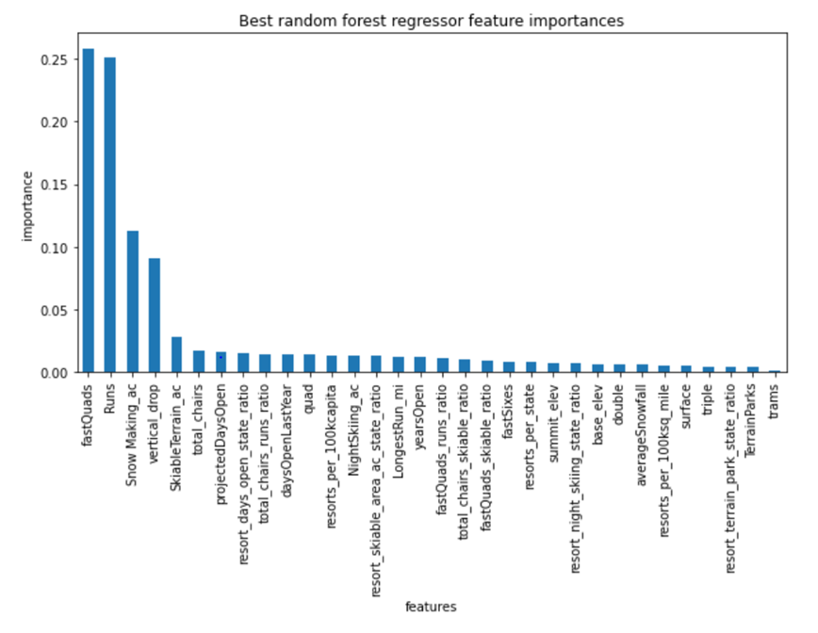
Features that came up as important in the modeling:
Vertical drop
Snow Making area
Total chairs
fastQuads
Runs
LongestRun length
trams
SkiableTerrain area

Slide 6
Two scenario that we’ve discarded
Scenario 3: Same as the scenario 2, but adding 2 acres of snow making cover.
Why we discard this scenario: Our model shows that such a small increase in the snow making area makes no difference to the ticket price and revenue, but it would increase our operation costs.
Scenario 4: Increase the longest run by 0.2 mile to boast 3.5 miles length, requiring an additional snow making coverage of 4 acres.
Why we discard this scenario: Our model shows that it makes no difference to ticket price.

Slide 7

Summary
We can reduce our operation costs by closing down some least used runs and increase ticket price and revenue by adding a run to increase the vertical drop by 150 feet. Some other information about the operation costs, for examples, maintenance fee of a run and operation cost of snow making per acre, would be useful to help us make futher decisions.

